Slide 1

Week 5 Demo
Jeffery

Slide 2
Review
Database & SQL
  Create & Use
  Table operation
  Select statement
Linq
  How exactly it works
  Delegates & Lambda
Entity Framework
  ORM
  How to access data via .NET core

Slide 3
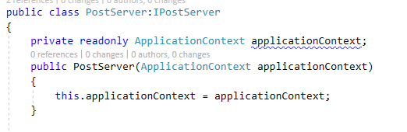
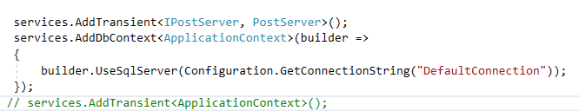
DJ for DbContext
Server Class
Services Config

Slide 4
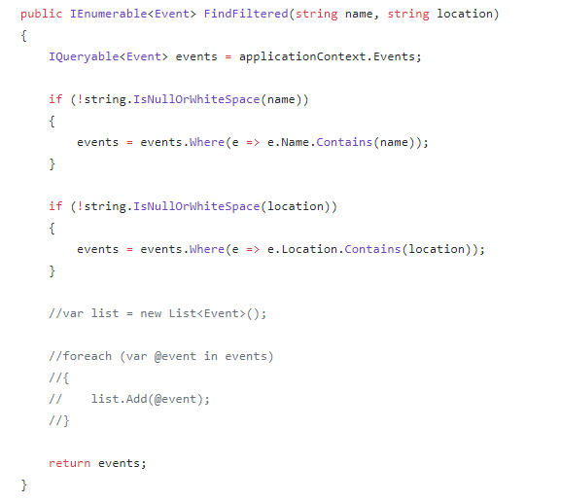


Accessing DB

Slide 5
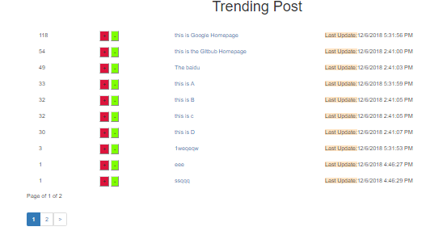
X.PagedList
https://github.com/TroyGoode/PagedList

